Slide 1
Tela | Links | Complexidade | Nivel | Funções | Obs
Home | My Car Claim Info | Simples | 0 |  | My Challenges só lista My Rewards só lista My Cloud não implementada
My Car | My Route My Dashboard My Policy New Claim | Simples | 0 | New Claim Call Ambulance Call Police | Nova
New Claim | Wizard (Policy Info) | Simples | 0 | OK Cancel | Somente função Report Accident
Policy Info | Driver Parties Involved | Simples | 0 | Send Info via SMS/E-mail | Função em nível 1
Parties Involved | Car Damage | Simples | 0 | Add Parties
Car Damage | Car Status Repair Shopping Review Accident | Simples | 0 | Car Status | Towing em nível 0 Courtesy car em nível 1 Courtesy for others em nível 2
Review Accident | Evidence of Accident | Simples | 0 | Mapa com Geoloc
Evidence of Accident | My Claims | Simples | 0 | Fotos/Videos Sent Screen | Fotos/Videos em nível 1
Car Status | Car Damage | Simples | 0 |  | Nova
Repair Shopping | About Shopping | Simples | 0 | Distância até a Repair Shopping | Necessário Massa
About Shopping | Review Accident | Simples | 0 | Reviews Rating Call Shop Request sent screen | Necessário Massa
Driver | Policy Info | Simples | 0 |  | Nova
Claim Info | Claim Resume | Simples | 0 | Claim Status Claim Progress Service Status
Claim Resume | Claim Info | Simples | 0 |  | Nova

Slide 2
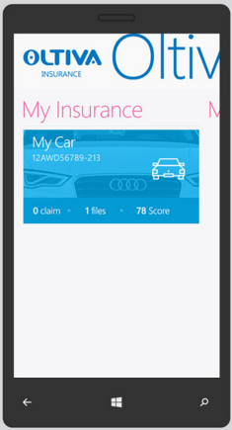
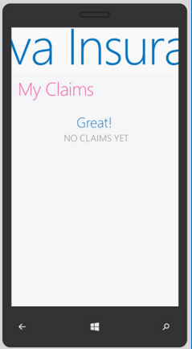
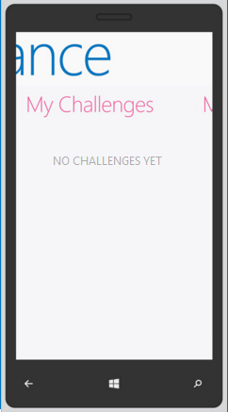
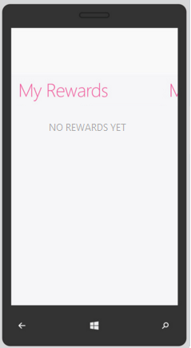
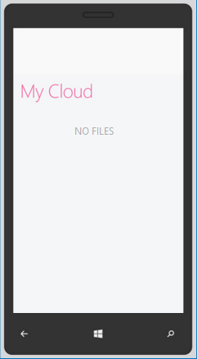

Slide 3
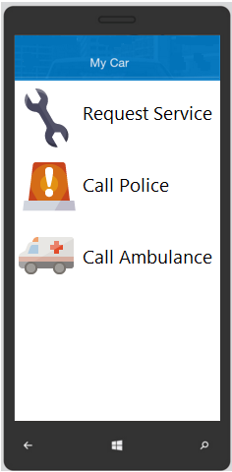
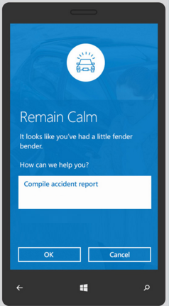

Slide 4
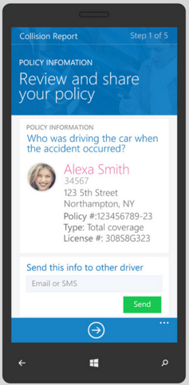
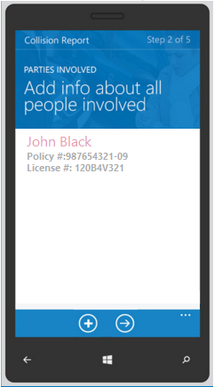
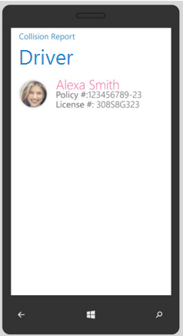
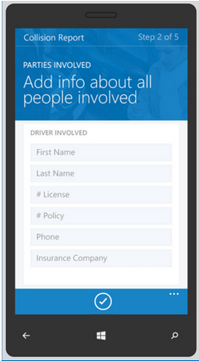

Slide 5
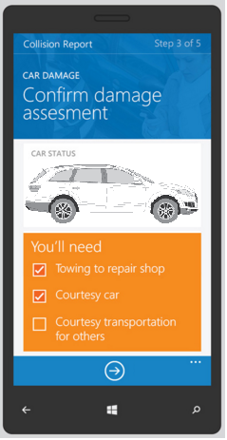
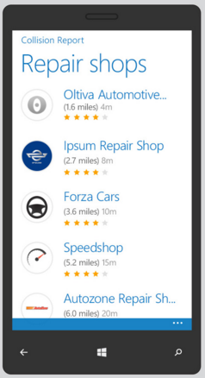
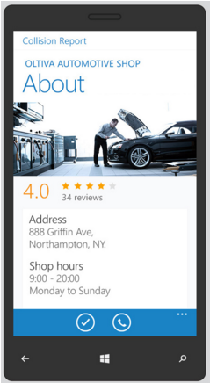
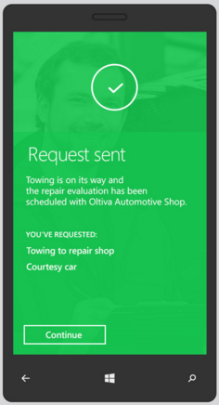
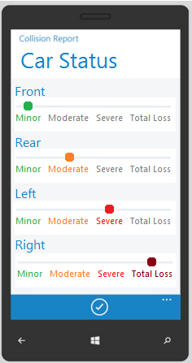

Slide 6
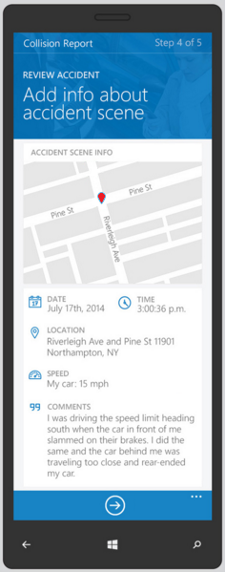
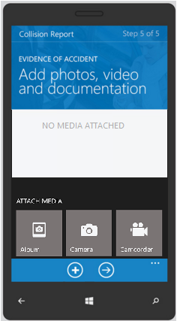
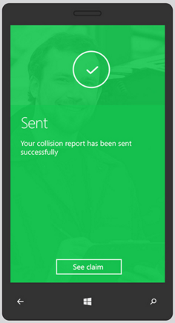

Slide 7
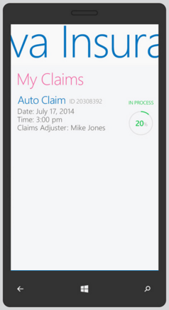
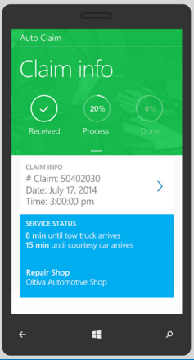
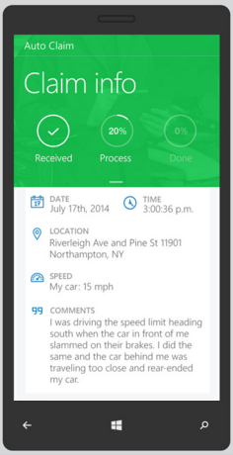

Slide 8
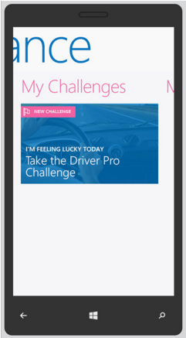
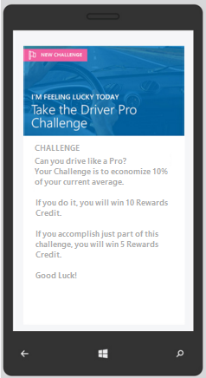

Slide 9
